Slide 1

Even-odd Sorting high performance computing
Parallel Implementation Using OpenMP and MPI
10/29/2025

Slide 2
Agenda
Introduction - Even-Odd Sorting
Algorithm Overview
Why Use Even-Odd Sorting in HPC?
Parallelization Strategies
OpenMP Implementation
MPI Implementation
Performance Considerations
Real-World Applications
Challenges and Future Directions
Conclusion
References
Q&A

Slide 3
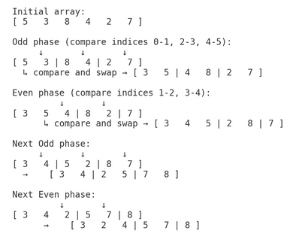
introduction
Even-Odd Sorting also known as Odd-Even Transposition Sort; is a parallel sorting algorithm based on the comparison of adjacent elements.
Concept: Iteratively compares and swaps elements in even and odd phases to sort a sequence.
Why HPC?: Ideal for parallel architectures due to its regular communication pattern and data locality.

Slide 4

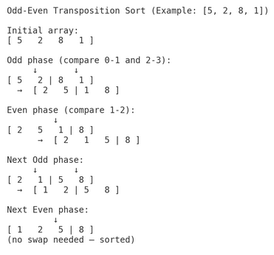
Overview of Even-odd Sorting Algorithm
Steps:
Divide the array into pairs of adjacent elements.
Even Phase: Compare and swap elements at even indices (0-1, 2-3, ...).
Odd Phase: Compare and swap elements at odd indices (1-2, 3-4, ...).
Repeat for at most n iterations (where n is the array size) to ensure sorting.
Sequential Time Complexity: O(n²)
Parallel Time Complexity: O(n) with n processors

Slide 5

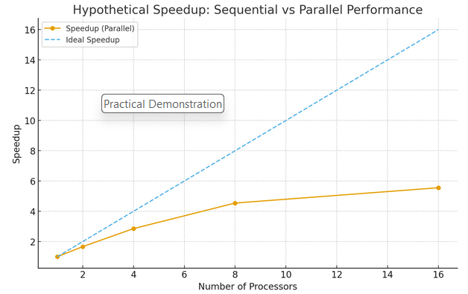
Why use even-odd sorting in hpc
Advantages:
Simple to implement in parallel environments.
Regular communication pattern suits distributed and shared-memory systems.
Scales well with the number of processors.
Challenges:
Requires many iterations for large datasets.
Communication overhead in distributed systems (e.g., MPI).
HPC Relevance: Ideal for architectures like multi-core CPUs, GPUs, or distributed clusters.
Notes:
This figure shows a hypothetical speedup curve comparing sequential vs. parallel performance as the number of processors increases. The dashed line is the ideal linear speedup, and the solid curve shows realistic speedup with diminishing returns due to overhead and parallelization limits.

Slide 6
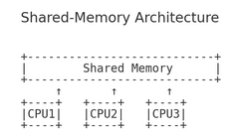
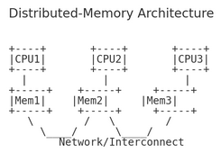
Parallelization Strategies
Shared-Memory (OpenMP):
Divide comparisons across threads.
Each thread handles a subset of even/odd pairs.
Synchronization needed to avoid race conditions.
Distributed-Memory (MPI):
Divide array across processes.
Each process sorts its local data and exchanges boundary elements.
Requires inter-process communication for swaps.
Hybrid Approaches: Combining OpenMP and MPI for large-scale systems.

Slide 7
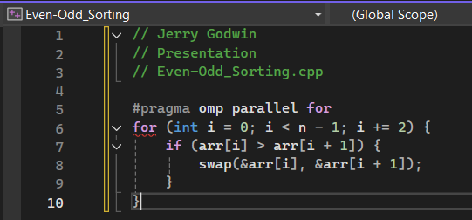
OpenMP Implementation
Uses OpenMP for parallelizing even-odd sorting on shared-memory systems.
Key Features:
Parallelize loops for even and odd phases.
Use #pragma omp parallel for to distribute comparisons.
Ensure thread safety with barriers.
Notes:
The OK Code Implementation:
The code initializes an array with increasing integers.

Slide 8
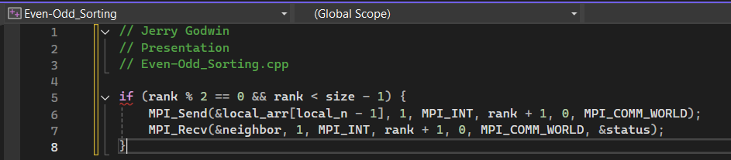
MPI Implementation
Uses MPI for distributed-memory systems, splitting the array across processes.
Key Features:
Each process sorts its local subarray.
Boundary elements are exchanged between neighboring processes.
Uses MPI_Send and MPI_Recv for communication.

Slide 9
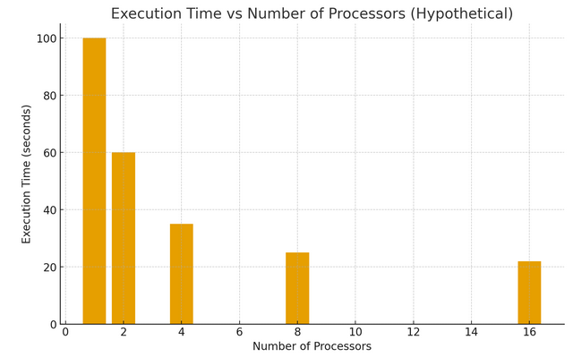
Performance Considerations
Scalability: Linear speedup possible with sufficient processors but limited by communication overhead.
Bottlenecks:
OpenMP: Thread synchronization and memory contention.
MPI: Inter-process communication latency.
Optimization Strategies:
Minimize communication in MPI by overlapping computation and communication.
Use cache-friendly data access in OpenMP.

Slide 10

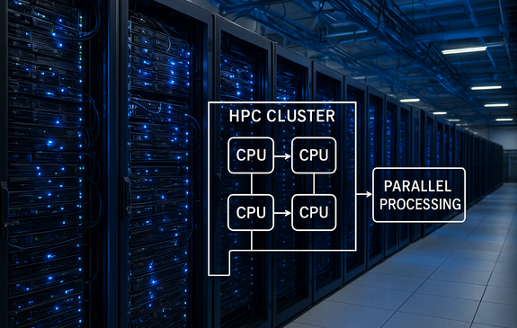
Real-World Applications
Use Cases:
Sorting large datasets in scientific simulations (example: particle physics, climate modeling).
Preprocessing data for parallel machine learning algorithms.
Database query optimization in distributed systems.
HPC Systems: Used in supercomputers, cloud clusters, and GPU-based systems.

Slide 11
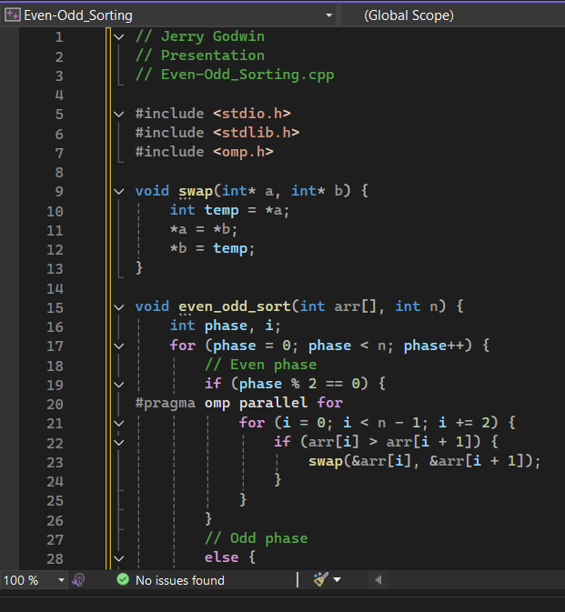
Example of openmp(ok)
The code showcasing a parallel even-odd sort implementation using OpenMP
Key Characterictics
Parallelization
Synchronization
Scalability
Notes:
Explanation:
Parallelization: The #pragma omp parallel for directive splits the loop iterations across threads for even and odd phases.
Synchronization: Implicit barriers at the end of each parallel for ensure all threads complete before moving to the next phase.
Scalability: Works well on multi-core CPUs but may face memory contention for very large arrays.

Slide 12
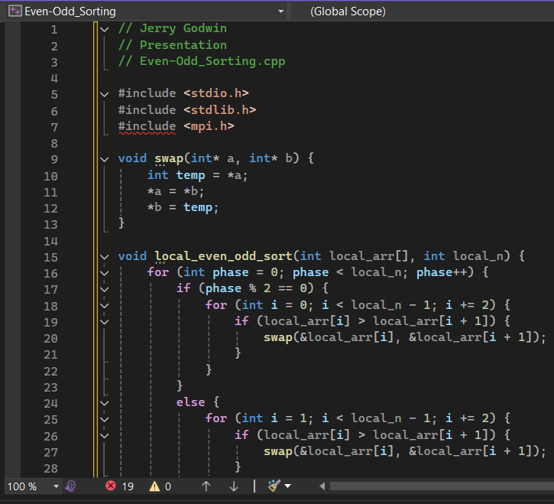
Sample of – mpi
The code showcasing a parallel even-odd sort implementation using MPI for distributed memory.
Key Characterictics
Parallelization
Synchronization
Scalability
Notes:
Explanation:
Data Distribution: The array is scattered across processes using MPI_Scatter.
Local Sorting: Each process sorts its subarray using even-odd sorting.
Global Exchange: Processes exchange boundary elements in even and odd phases, mimicking the global even-odd sort pattern.
Communication: Uses MPI_Send and MPI_Recv for point-to-point communication between neighboring processes.
Scalability: Scales with the number of processes but is limited by communication overhead.

Slide 13
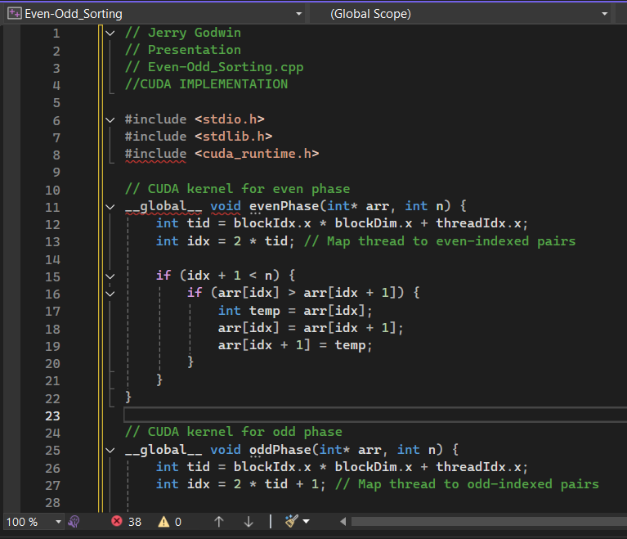
Sample code for - CUDA
The code showcasing a parallel even-odd sort implementation using CUDA implementation.
Key Characteristics
Kernels
Shared memory usage
Thread & Block Configuration
Synchroniation (--synthesisthreads(), cudaDeviceSynchronize()
Timing & verification
Notes:
Optimizations
Shared Memory: Reduces global memory accesses, which are 100-1000x slower than shared memory.
Coalesced Access: Threads access contiguous memory locations when loading/storing data, improving memory bandwidth.
Minimized Divergence: The comparison logic is simple, reducing branch divergence within warps.
Scalability: The code scales to large arrays by dividing work across multiple blocks, though performance may degrade for very large n due to the O(n) iterations.
Limitations
Iteration Count: The algorithm requires n iterations, which is inefficient for large arrays compared to other GPU sorting algorithms (e.g., bitonic sort or radix sort).
Boundary Handling: The current implementation assumes n is even and does not handle boundary cases for odd-sized arrays or partial blocks optimally.
Global Synchronization: Launching a kernel per phase introduces overhead, as kernel launches are costly.

Slide 14

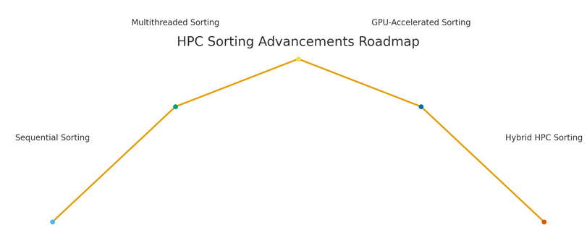
Challenges and Future Directions
Challenges:
High communication costs in MPI for large datasets.
Load balancing issues with uneven data distributions.
Future Directions:
Integration with GPU-based parallel sorting (such as CUDA).
Hybrid MPI+OpenMP implementations for exascale computing.
Adaptive algorithms to reduce iterations for nearly sorted data.

Slide 15
Conclusion
Even-Odd Sorting is a robust algorithm for parallel HPC environments.
OpenMP and MPI provide flexible implementations for shared and distributed systems.
Key to success: Balancing computation and communication.
Encourages exploration of hybrid and GPU-based approaches for future HPC challenges.
Notes:
Optimizations
Shared Memory: Reduces global memory accesses, which are 100-1000x slower than shared memory.
Coalesced Access: Threads access contiguous memory locations when loading/storing data, improving memory bandwidth.
Minimized Divergence: The comparison logic is simple, reducing branch divergence within warps.
Scalability: The code scales to large arrays by dividing work across multiple blocks, though performance may degrade for very large n due to the O(n) iterations.
Limitations
Iteration Count: The algorithm requires n iterations, which is inefficient for large arrays compared to other GPU sorting algorithms (e.g., bitonic sort or radix sort).
Boundary Handling: The current implementation assumes n is even and does not handle boundary cases for odd-sized arrays or partial blocks optimally.
Global Synchronization: Launching a kernel per phase introduces overhead, as kernel launches are costly.

Slide 16
References
“Parallel Programming in C with MPI and OpenMP” by Michael J. Quinn. (Book)
“Parallel Sorting Algorithms” by Selim G. Akl. (Article)
MPI documentation, OpenMP specifications.NVIDIA CUDA Documentation: https://docs.nvidia.com/cuda/
OpenMP Specifications: https://www.openmp.org/
CERN Open Data Portal: https://opendata.cern.ch/
Open-Source Libraries: Boost.Sort, NVIDIA Thrust.

Slide 17
THANK YOU
Jerry Diabor​
202-230-0215​
diaborj1105@students.bowiesdtate.edu
https://github.com/jedgod/Even_Odd-Sorting-Algorithms​

